Slide 1
Clarkson’s algorithms
Lee-Ad Gottlieb

Slide 2

Hyperplanes
Perceptron:
Runtime: $O\left(1/{γ^{2}}\right)$, expensive when $γ$is small
Doesn’t return max-margin hyperplane

Slide 3
Hyperplanes
How expensive is it to find the max-margin hyperplane separator?
Let’s try brute force
Definition: The Support Vectors of S are those which define the max-margin of S
If even one of them is removed, a bigger margin is possible (assuming no ties)
Any subset of S that contains the Support Vectors has the same max-margin
In d-dimensional space, at most d+1 support vectors

Slide 4
Hyperplanes
How expensive is it to find the max-margin hyperplane separator?
Brute force:
Try all combinations of d+1 points out of n points in S. One combination has all support vectors
Runtime: n^{O(d)}
Finds max-margin hyperplane
Can we improve on the runtime?
Clarkson’s algorithms

Slide 5
Preliminaries
VC dimension
A line can shatter 3 points
A line cannot shatter any collection of 4 points
So a line has VC dimension of 3
More generally, a d-dimensional hyperplane has VC dimension: d+1.

Slide 6
Clarkson
Clarkson gave two algorithms
They breaks down the problem into smaller sub-problems:
Let P be an algorithm that finds the max-margin separator.
Let P(n,d) on a set of size n with dimension d
For example, the brute-force algorithm has
P(n,d) = n^{O(d)}
Instead of running P on all our set, we’ll run it on sub-problems of size smaller than d

Slide 7
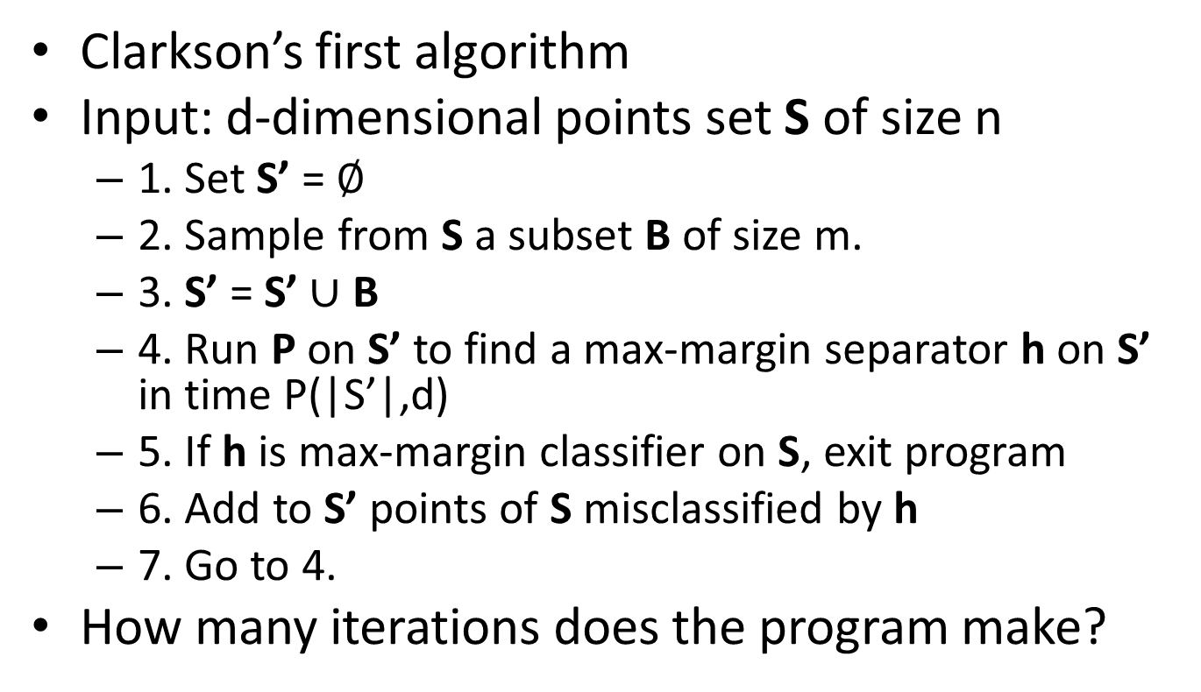
Clarkson 1
Clarkson’s first algorithm
Input: d-dimensional points set S of size n
1. Set S’ = $∅$
2. Sample from S a subset B of size m.
3. S’ = S’ $∪$ B
4. Run P on S’ to find a max-margin separator h on S’ in time P(|S’|,d)
5. If h is max-margin classifier on S, exit program
6. Add to S’ points of S misclassified by h
7. Go to 4.
How many iterations does the program make?

Slide 8
Clarkson 1
For simplicity, assume we have only one blue point and are sampling from the reds.

Slide 9
Clarkson 1
Sample a subset B of size m

Slide 10
Clarkson 1
Add B to S’
S’

Slide 11
Clarkson 1
Run P on S’ in time P(|S’|,d)

Slide 12
Clarkson 1
Compute max-margin h on S’

Slide 13
Clarkson 1
Find points misclassified by h, add them to S’
Add these
points to S’
At least one of
these must be a
Support Vector

Slide 14
Clarkson 1
Run P on S’, find new max-margin separator h

Slide 15
Clarkson 1
Add misclassified points to S’
Add these
points to S’

Slide 16
Clarkson 1
Run P again on S’, find max-margin h, and exit
“safe zone”

Slide 17
Analysis of Clarkson 1
How many iterations does the algorithm make?
Claim: In every iteration, h is either consistent on all of S, or misclassifies at least one Support Vector
Proof: By definition, a max-margin hyperplane that is consistent on all Support Vectors is consistent on all points.
There are d+1 support vectors, so there are at most d+2 iterations.

Slide 18
Analysis of Clarkson 1
How big should our should our samples from S be?
Recall: With probability 1-1/m,
any hypothesis that correctly classifies all point of an m-point sample S’, misclassifies at most
O( n/m (log m + d_{VC} log(m/d_{VC})) ) =
O*(d_{VC}n/m)
points of S.
Our hyperplanes have VC-dimension d+1

Slide 19
Analysis of Clarkson 1
Choose m= O(dn^{.5})
At each iteration, h misclassifies
O(d_{VC}n/m) = O(dn / dn^{.5}) = O(n^{.5})
points.
After d+2 iterations, |S’|= O(dn^{.5})

Slide 20
Analysis of Clarkson 1
Synopsis:
C1 brakes the problem down into d computations of P(dn^{.5},d).
For each hyperplane, did dn work.
P(n,d) = O(d²n) + d P(dn^{.5})
If P is brute force algorithm, this gives a runtime of about d³n^{d/2} instead of about n^{d}.

Slide 21
Clarkson 2
Clarkson’s second algorithm uses iterative reweighting.
Multiple iterations of sampling with replacement
Each iteration produces a hyperplane
Each point has a weight. Think of this as copies of the point.
Let’s take a look…

Slide 22
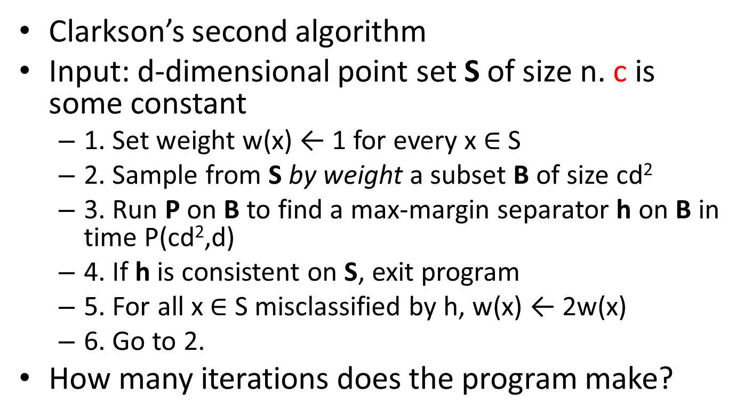
Clarkson 2
Clarkson’s second algorithm
Input: d-dimensional point set S of size n. c is some constant
1. Set weight w(x) ← 1 for every x $∈$ S
2. Sample from S by weight a subset B of size cd²
3. Run P on B to find a max-margin separator h on B in time P(cd²,d)
4. If h is consistent on S, exit program
5. For all x $∈$ S misclassified by h, w(x) ← 2w(x)
6. Go to 2.
How many iterations does the program make?

Slide 23
Clarkson 2
Sample a subset B of size m
1
1
1
1
1
1
1
1
1
1
1
1
1
1
1

Slide 24
Clarkson 2
1
1
1
1
1
1
1
1
1
1
1
1
1
1
1

Slide 25
Clarkson 2
At least one
of these points
Must be a SV
1
1
1
1
1
1
1
1
1
1
1
1
1
1
1

Slide 26
Clarkson 2
Reweight
these
points
2
2
2
1
1
1
1
1
1
1
1
1
1
1
1

Slide 27
Clarkson 2
Next iteration
2
2
2
1
1
1
1
1
1
1
1
1
1
1
1

Slide 28
Clarkson 2
Sample again a subset B of size m
2
2
2
1
1
1
1
1
1
1
1
1
1
1
1

Slide 29
Clarkson 2
Compute max-margin separator
2
2
2
1
1
1
1
1
1
1
1
1
1
1
1

Slide 30
Clarkson 2
Double the weight of misclassified points
2
4
2
1
1
2
1
1
1
2
1
1
1
1
1

Slide 31
Clarkson 2
Next iteration
2
4
2
1
1
2
1
1
1
2
1
1
1
1
1

Slide 32
Clarkson 2
Sample a subset B of size m
2
4
2
1
1
2
1
1
1
2
1
1
1
1
1

Slide 33
Clarkson 2
Compute max-margin separator
2
4
2
1
1
2
1
1
1
2
1
1
1
1
1

Slide 34
Clarkson 2
Double the weight of misclassified points
2
4
2
1
1
4
1
1
1
4
1
1
2
1
1

Slide 35
Clarkson 2
Next iteration
2
4
2
1
1
4
1
1
1
4
1
1
2
1
1

Slide 36
Clarkson 2
Sample a set B of m points
2
4
2
1
1
4
1
1
1
4
1
1
2
1
1

Slide 37
Clarkson 2
Compute max-margin separator
Consistent with all of S – exit!
2
4
2
1
1
4
1
1
1
4
1
1
2
1
1

Slide 38
Analysis of Clarkson 2
Quite surprisingly, this actually works.
We need only two simple facts to prove correctness. (next slide)
Important caveat:
If the weight of points misclassified by h is very heavy (2n/cd or more), complete iteration and resample.
Chance of this happening is small:
O(d_{VC}n/m) = O(dn / d²) = O(n/d)

Slide 39
Analysis of Clarkson 2
Fact 1
At each iteration, the weight of at least one SV is doubled.
After d+1 iterations, the weight of the set of SV at least doubles.
After k(d+1) iterations, the weight of the set of SV is at least 2^{k}(d+1).
Fact 2
At each iteration, the weight of the entire set increases by at most 2w(S)/cd
After kd iterations, the weight of the entire set is at most
(1+2/cd)^{kd}n < e^{2k/c}n.
The weight of the set of SV can’t be greater than the weight of entire set
2^{k}d < e^{2k/c}n
kd = O(d log n) iterations

Slide 40
Analysis of Clarkson 2
Synopsis:
O(d log n) iterations.
Each iteration requires O(dn) + P(d²,d) work
Total: O(d²n log n) + d log n P(d²)
Combined with C1, this gives
P_{C2}(n) = d²n + d² log n P(d²)

